Slide 1
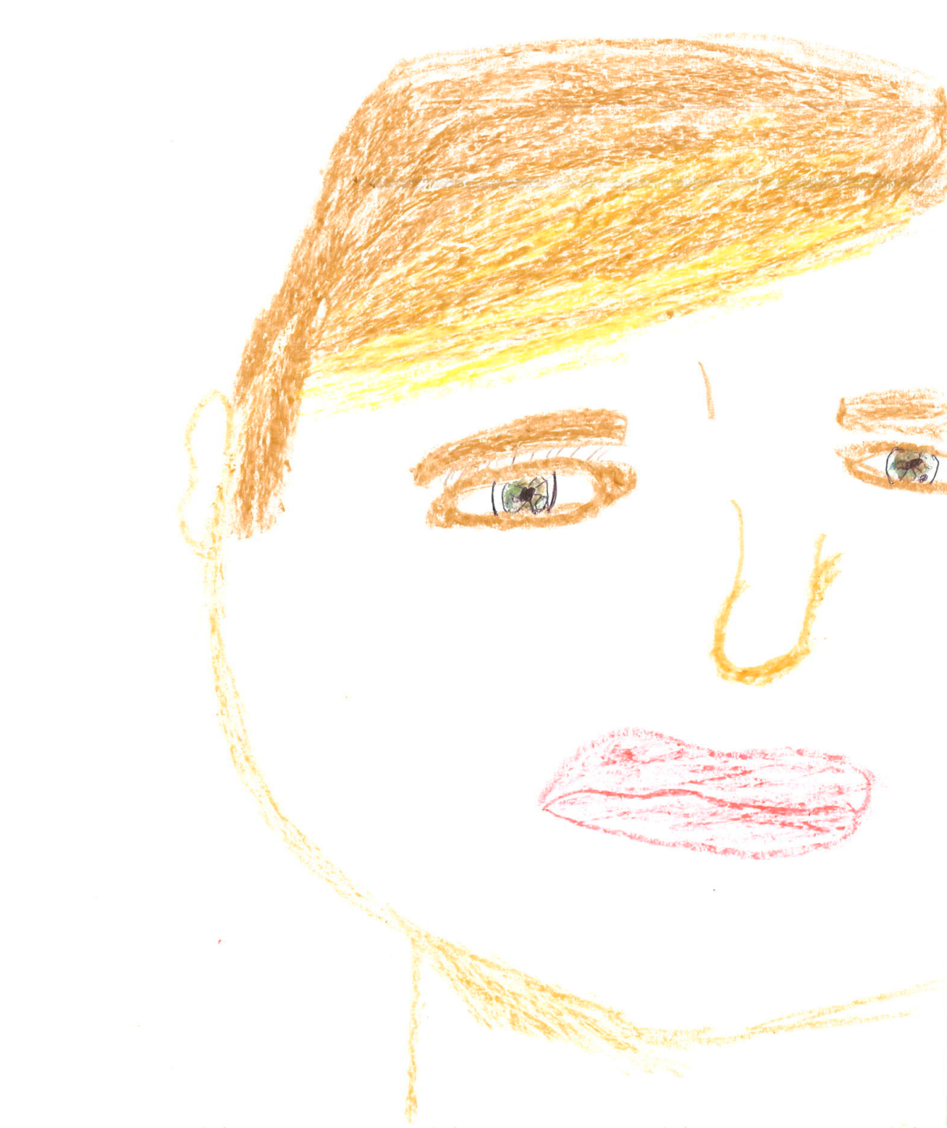
Update on the Care of Transgender Youth: Social-Emotional Considerations and Medical Interventions Meredith R. Chapman, MD
Ximena Lopez, MD
GENder, Education and Care Interdisciplinary Support Program (GENECIS)
Children’s Medical Center Dallas
Notes:
Title: Across the Spectrum: Ethical Considerations of the Transgender Youth
Objectives:
1. Discuss available resources for pediatric providers in order to treat or care for transgender youth.
2. Discuss the current ethical issues of gender affirmation and transition, physically and emotionally in the transgender youth.
3. Raise awareness and sensitivity in physicians and their health care teams by reviewing perspectives, the various cultural and social elements, and the philosophical issues associated with transgendered youth.

Slide 2
Learning Objectives
1. Understand and correctly use gender-related terms and definitions
2. Recognize mental health issues in gender diverse youth
3. Describe the psychosocial impact of gender differences and the risks gender diverse youth face
4. Understand the risks and benefits of puberty suppression and/or “cross-sex hormone” therapy during adolescence
5. Discuss some of the current ethical issues of gender affirmation and transition, physically and emotionally in transgender youth
6. Discuss available resources for pediatric providers in order to best treat or care for transgender youth

Slide 3
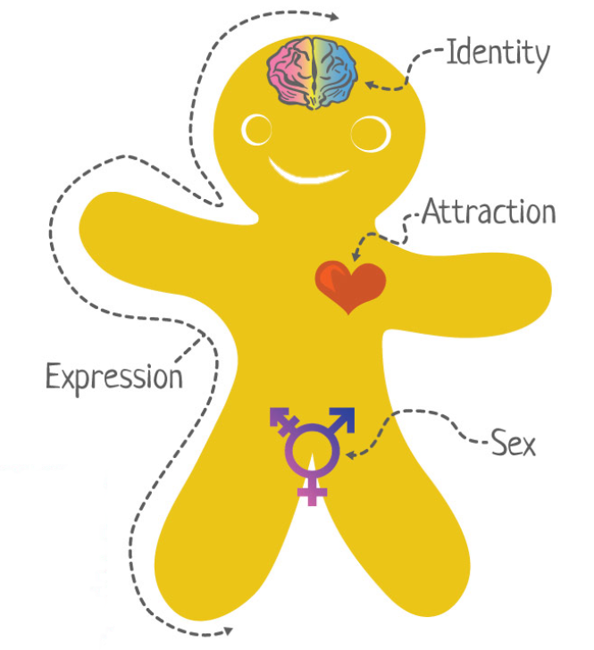
http://itspronouncedmetrosexual.com/2015/03/the-genderbread-person-v3/

Slide 4
Gender-Related Terms and Definitions
Androgynous
Identifying and/or presenting as neither distinguishably masculine or feminine
Cisgender (Cis)
Gender identity or expression aligns with the sex assigned at birth
Gender Binary
Gender model in which only 2 genders exist
Solidly fixed
Biologically based
Various expectations for behavior, appearance, and feelings
Notes:
• Definitions are always evolving, language can’t keep up

Slide 5
Gender-Related Terms and Definitions
Gender-Expansive
Wider and more flexible range of gender identity and/or expression
Gender Identity
One’s innermost concept of self as male, female, a blend of both, or neither
How individuals perceive themselves and what they call themselves
Can be the same or different from the sex assigned at birth

Slide 7
Gender-Related Terms and Definitions
Gender Expression
The ways in which people externally communicate their gender identity to others
Clothing
Hair style
Behavior/mannerisms
Voice
Notes:
In reverse people assign gender to others based on their appearance, mannerisms, and other characteristics

Slide 8
Gender-Related Terms and Definitions
Gender Transition
Process by which some people strive to more closely align their internal knowledge of gender with its outward manifestation
Social transition
Dressing, using names/pronouns and/or being socially recognized as the “other” gender
Physical transition
Modify one’s body through medical and/or surgical interventions

Slide 10
Gender-Related Terms and Definitions
Sex
Designation made at birth as “male” or “female” based on an individual’s genitalia
Frequently assumed to be the same as gender
Only one aspect of gender
Sex + Gender Identity + Gender Expression
Sexual Orientation
An individual’s enduring physical, emotional, romantic and/or spiritual attraction to another
Gender ≠ Sexual Orientation

Slide 11
Gender-Related Terms and Definitions
Transgender
Umbrella term
People whose gender identity and/or expression is different from cultural expectations based on the sex assigned them at birth
MtF=“affirmed female”(transwoman)
FtM=“affirmed male”(transman)
Misgender: referring to someone as a gender different from what they self-identify

Slide 12
For some kids, their body might be a male body but inside they might feel like a girl. Or they might have a female body, but inside, they might feel like a boy. Have you ever had feelings like that?
What would you like me to call you? What pronouns would you like me to use?
Your gender is the way you experience yourself – for many people that’s either male or female, and for some people it might be something else
Notes:
I don’t want to make assumptions about the kind of relationships you have, or how you see yourself. I want you to let me know, so that I can really get to know you and understand what’s going on in your life.
Is there anything about you that would be important for us to know about, whether it’s your race, your ethnicity, sexual orientation, gender, religion, or background?

Slide 13
Gender Dysphoria: Prevalence
Scarce data: Minimum estimates at best
MtF 1:12,000-1:45,000
FtM 1:30,000-1:200,000
In the US, 0.3% of adults identify as transgender
Rates are thought to be exceptionally higher than reported
Notes:
• Rates exceptionally higher than previously reported
• Emory University estimated 200-700/100,000; old estimate 1/30,000 assigned females or 1/11,000 assigned males

Slide 14
Gender Dysphoria: Etiology
Gender Identity is organic
Biological in nature and hard-wired
Environment plays nearly no role
Not a result of rearing or childhood events
Not due to an emotional disorder
Notes:
• Gender = social construct, not fixed, changes over time, evolves
• Taught by parents, enforced by media, culture, religion
• Gendered interactions start even before birth and shortly thereafter
• Society polices this, gender nonconforming kids are most bullied
• Pink was a boys color in the late 1800’s and early 1900’s, girls couldn’t wear pants, men wore lace and had long hair in pony tails

Slide 15
Gender Dysphoria: Etiology
Gender is a social/societal construct
Changes over time
Gendered interactions start even before birth
Taught by parents, reinforced by media, culture, religion
Policed by society
Notes:
The use of pink and blue emerged at the turn of the century, the rule being pink for boys, blue for girls. Since pink was a stronger color it was best suited for boys; blue was more delicate and dainty and best for girls. And in 1921, the Women's Institute for Domestic Science in Pennsylvania endorsed pink for boys, blue for girls.

Slide 16
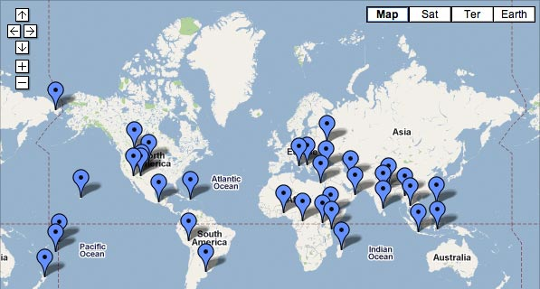
On nearly every continent, and for all of recorded history, thriving cultures have recognized, revered, and integrated more than two genders.
Independent Lens Two Spirits www.pbs.org/independentlens/two-spirits/map.html
Notes:
Has existed throughout history in many cultures

Slide 17
Gender Diverse Cultures
Native American tribes including: Blackfoot Confederacy, Lakota, Mohave, Navajo, and Zuni
Hawaii
Mahu- gender role somewhere between or encompassing both masculine and feminine characteristics
Thailand
Kathoey “ladyboys”- born male but “having a female heart”
Australia
Sistergirls and brotherboys
New Zealand
Maori wakawahine and wakatane

Slide 18
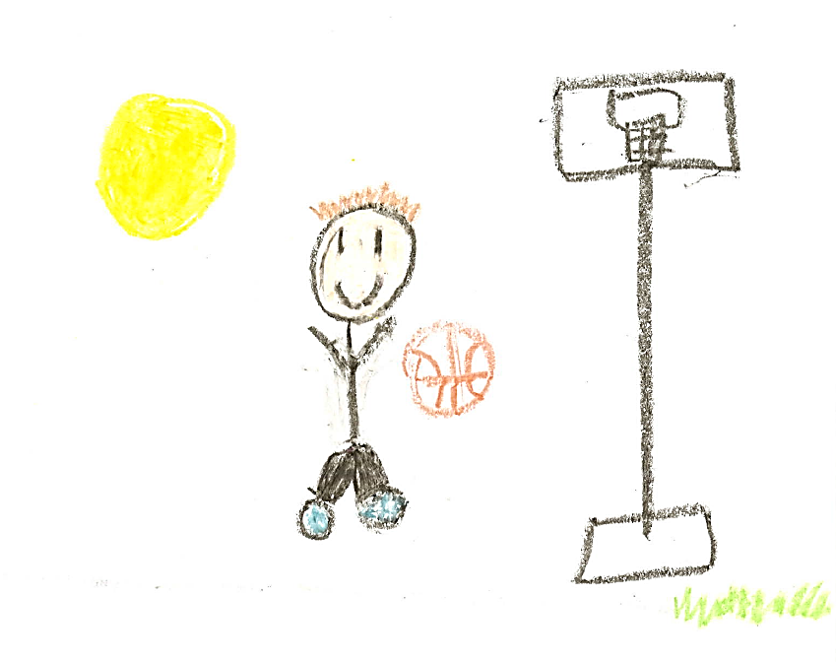

Slide 19
Phenomenology in Children
Children of any age may show features that could indicate gender dysphoria
Heterogeneity in features:
Prefer clothes, toys, and games that are commonly associated with the other sex and prefer playing with other-sex peers
Express a wish to be of the other sex and be unhappy about their physical sex characteristics and functions
Some children demonstrate extremely gender-nonconforming behavior and wishes
Persistent and severe discomfort with their primary sex characteristics

Slide 20
“All the girls were doing Barbie dolls and nail polish, and I just wasn’t one of them. All the boys were doing skateboards and helmets, and I wanted to do that stuff. I never felt right in that body.”

Slide 21
Diagnostic Frameworks
ICD 10
Gender Identity Disorder of Childhood
Separate criteria for assigned males and females
Overarching is persistent and intense distress about being the assigned sex and a stated desire to be or insistence that one is the opposite
DSM 5
Gender Dysphoria in Children
A marked incongruence between one’s experienced/expressed gender and assigned gender, of at least 6 months’ duration
Notes:
in in

Slide 23
Phenomenology in Adolescents
Dysphoric feelings intensify and body aversion will develop or increase as secondary sex characteristics develop
More extreme gender nonconformity in childhood is associated with persistence of gender dysphoria into late adolescence and early adulthood
Many, but not all, gender dysphoric adolescents have a strong wish for hormones and surgery
Increasing numbers of adolescents have already started living in their desired gender role upon entering high school
It is more common for adolescents with gender dysphoria to have higher prevalence rates of:
Internalizing disorders (anxiety and depression)
Externalizing disorders (oppositional defiant disorder)
Autism spectrum disorders

Slide 24
Diagnostic Frameworks
ICD 10
Transsexualism
Desire to live and be accepted as a member of the opposite sex, usually accompanied by the wish to make one's body as congruent as possible with one's preferred sex through surgery and hormonal treatment
Presence of the transsexual identity for at least two years persistently
DSM 5
Gender Dysphoria in Adolescents and Adults
A marked incongruence between one’s experienced/expressed gender and assigned gender, of at least 6 months’ duration
Posttransition specifier

Slide 25
Gender Dysphoria is not the Same in Children and Adolescents
In children, the salient incongruence of assigned and affirmed gender is with gender expression or primary sex characteristics
Gender expression in play, clothing, peer preference
In adolescents secondary sex characteristics acquire increasing salience

Slide 26
Psychosocial Impact
Isolation
Social anxiety
Discrimination & Harassment
Bullying & Violence
School Avoidance
Physical & Sexual Abuse
Homelessness
Substance Abuse
At-risk Behavior
Notes:
Isolation
Many transgender/gender-nonconforming youth have the perception of being completely alone and misunderstood.
The authors of one study note that social stressors and ostracism from peers can explain a large amount of the depression experienced by transgender individuals.
Budge, S. L., Adelson, J. L., & Howard, K. A. S. (2013). Anxiety and depression in transgender individuals: The roles of transition status, loss, social support, and coping. Journal of Consulting and Clinical Psychology, 81(3), 545-557.
Social Anxiety
Discrimination & Harassment
About 2/3 of LGBT students reported having been sexually harassed (e.g. sexual remarks being made or being touched inappropriately) in school in the past year
PFLAG New York City. Statistics you should know about gay & transgender students. Retrieved from http://www.pflagnyc.org/safeschools/statistics
Bullying & Violence
Over 10% of LGBT students are physically assaulted because of their gender identity
PFLAG New York City. Statistics you should know about gay & transgender students. Retrieved from http://www.pflagnyc.org/safeschools/statistics
According to the National Coalition of Anti-Violence Programs (NCAVP) report in 2011, people who identify as transgender were 28% more likely to experience physical violence than those who are gender normative
Bolles, A. (2012). Violence against transgender people and people of color is disproportionately high, LGBTQH murder rate peaks [Web log post]. Retrieved from http://www.glaad.org/blog/violence-against-transgender-people-and-people-color-disproportionately-high-lgbtqh-murder-rate
School Avoidance
LGBT students are twice as likely to say that they were not planning on completing high school or going on to college
PFLAG New York City. Statistics you should know about gay & transgender students. Retrieved from http://www.pflagnyc.org/safeschools/statistics
Physical & Sexual Abuse
Homelessness
One in five transgender individuals have experienced homelessness at some point in their lives
National Center for Transgender Equality. Housing & homelessness. Retrieved from http://transequality.org/issues/housing-homelessness
Studies indicate that between 25-50% of homeless youth are LGBT and on the streets because of the sexual orientation or gender identity
PFLAG New York City. Statistics you should know about gay & transgender students. Retrieved from http://www.pflagnyc.org/safeschools/statistics
LGBT youth are overrepresented in foster care, juvenile detention, and among homeless youth
PFLAG New York City. Statistics you should know about gay & transgender students. Retrieved from http://www.pflagnyc.org/safeschools/statistics
Substance Abuse
LGBT youth who reported higher levels of family rejection during adolescence are 3 times more likely to use illegal drugs
PFLAG New York City. Statistics you should know about gay & transgender students. Retrieved from http://www.pflagnyc.org/safeschools/statistics
At-risk Behavior
Parental support is associated with more consistent condom use in a study of transgender female youth
Simons, L., Schrager, S. M., Clark, L. F., Belzer, M., & Olson, J. (2013). Parental support and mental health among transgender adolescents. Journal of Adolescent Health, 53, 791-793.

Slide 27
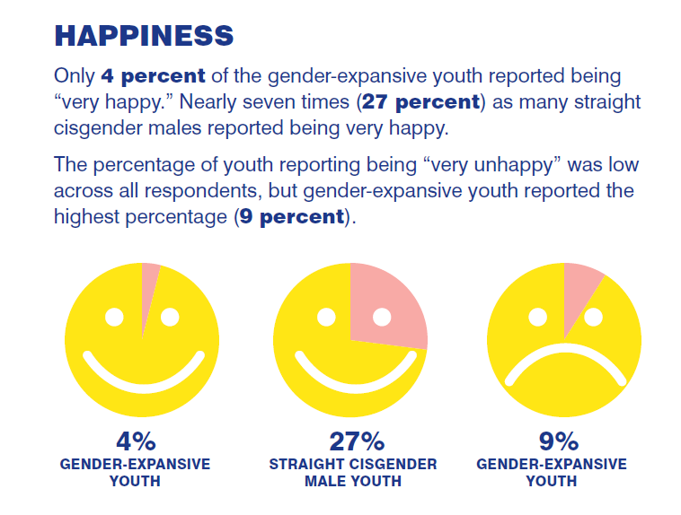

Slide 28
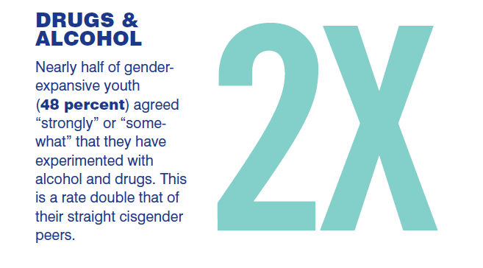

Slide 29
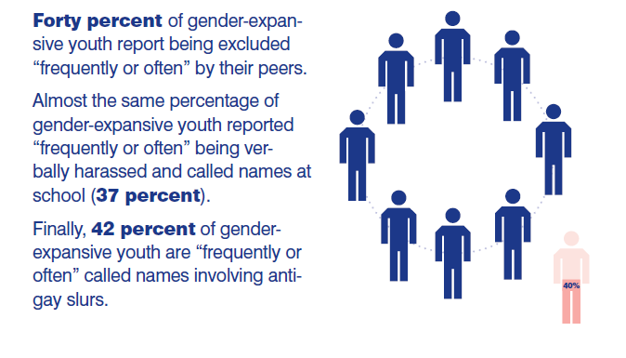

Slide 30
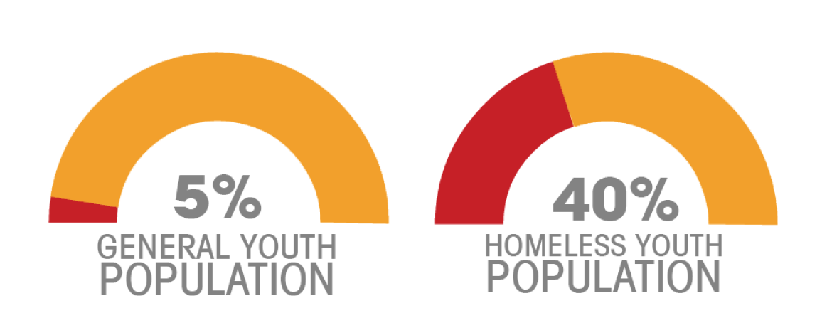

Slide 31
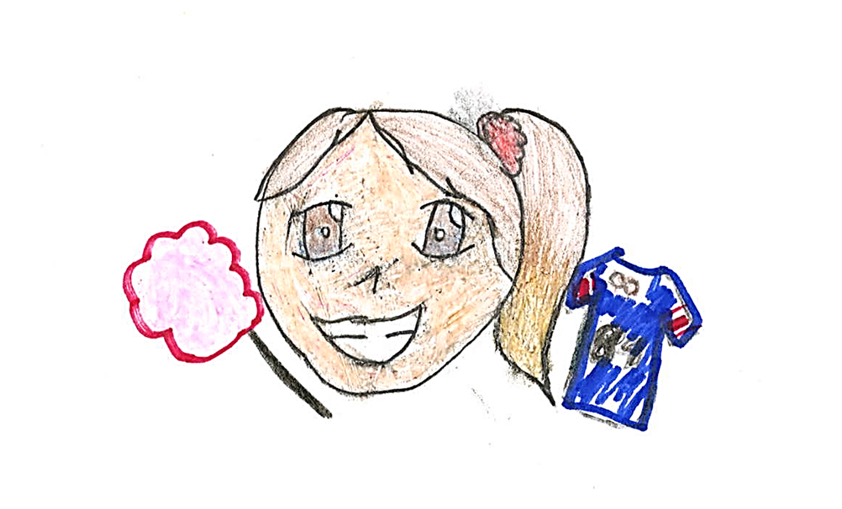
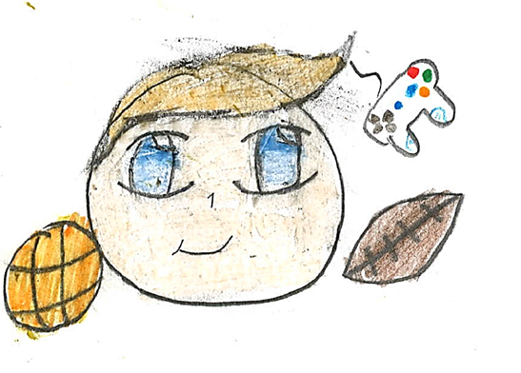
Best Treatment Practices for Gender Non-Conforming Prepubescent Youth

Slide 32
Emerging Findings From Empirical Research on Gender Non-Conforming Youth
Heterogeneous group
Notions of gender and gender identity vary with age
Prior to operational thinking (ages 5-7) gender identity= expression of gender
Majority of children do not persist into adolescence (desisters)
Many grow up to be gay, smaller proportion grow up to be heterosexual
No way at present to predict which children will persist vs. desist
Gender dysphoria that persists into adolescence is more likely than not to persist into adulthood

Slide 33
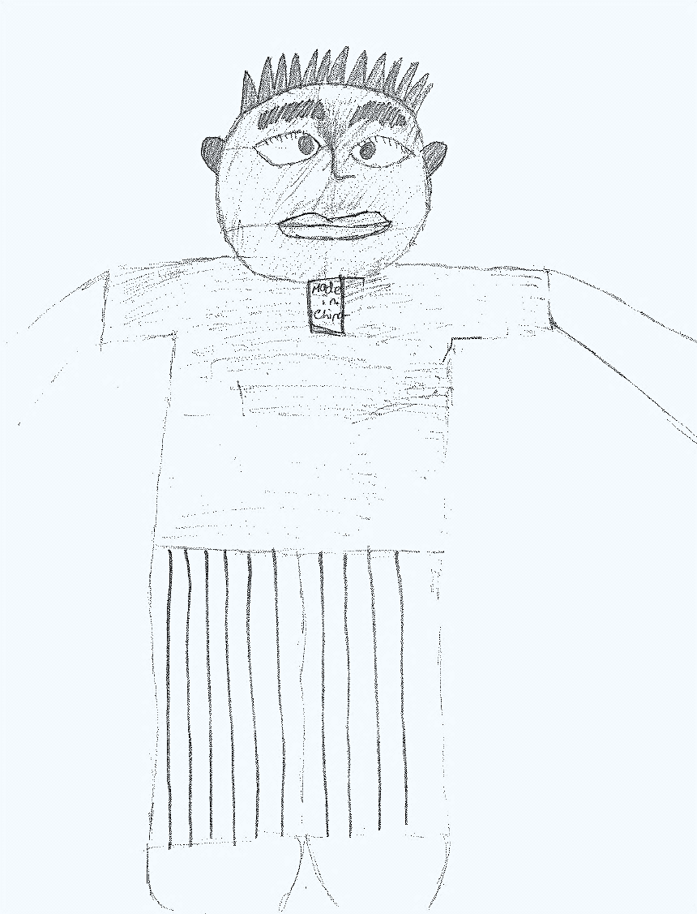

Slide 34
To Persist vs. Desist That is the question
Gender dysphoria during childhood does not inevitably continue into adulthood
Persistence rates of 6-23% in prepubertal children (mainly boys) referred for assessment of gender dysphoria (Cohen-Kettenis, 2001; Zucker & Bradley, 1995)
Assigned males more likely to identify as gay in adulthood than as transgender (Green, 1987; Money & Russo, 1979; Zucker & Bradley, 1995; Zuger, 1984)
Newer studies show a 12–27% persistence rate of gender dysphoria into adulthood (Drummond, Bradley, Peterson-Badali, & Zucker, 2008; Wallien & Cohen-Kettenis, 2008)

Slide 35
To Persist vs. Desist That is the question
For adolescents the rate of persistence of gender dysphoria into adulthood appears to be much higher
No formal prospective studies exist
In a follow-up study of 70 adolescents who were diagnosed with gender dysphoria and given puberty-suppressing hormones, all continued with actual sex reassignment, beginning with feminizing/masculinizing hormone therapy

Slide 36
There is no expert clinical consensus regarding the treatment of
prepubescent children who meet diagnostic criteria for gender dysphoria

Slide 37
Expert Opinion Prepubescent Children
Centre for Addiction and Mental Health, Toronto, Canada
Treatment aims:
Lessen gender dysphoria
Decrease cross-gender behaviors and identification
Expected treatment outcomes:
Decrease the likelihood of gender dysphoria persisting into adolescence and adulthood
Persistence is an undesirable outcome for various reasons including social stigma and need for lifelong medical interventions
Notes:
Toronto- natal boys are not permitted to dress in princess outfits or play with Barbie dolls. Instead directed towards more typically masculine activities

Slide 38
Expert Opinion Prepubescent Children
VU University Medical Center, Amsterdam
Treatment aims:
No direct efforts to lessen gender dysphoria or gender atypical behavior
Expected treatment outcomes:
No therapeutic target with respect to gender
Development of gender is allowed to unfold
If gender dysphoria is persistent assist in adolescent transition
If gender dysphoria does not persist assist in adjusting to natal gender
Notes:
Toronto- natal boys are not permitted to dress in princess outfits or play with Barbie dolls. Instead directed towards more typically masculine activities

Slide 39
Expert Opinion Prepubescent Children
University of California, San Francisco
Treatment aims:
Support a child in transitioning to a cross-gendered role without medical or surgical intervention
Change in clothing and presentation
Change in name(s) and/or pronouns
Change in restroom or locker room use
Expected treatment outcomes:
Adult transgender outcome is to be expected
Children who transition but do not persist can revert to their natal gender with no ill effects
Notes:
Toronto- natal boys are not permitted to dress in princess outfits or play with Barbie dolls. Instead directed towards more typically masculine activities

Slide 41
Clinical Ethical Considerations
Is prevention of persistence into adulthood an acceptable clinical activity?
Should parents be informed that the persistence of gender dysphoria is preventable?
Is it appropriate to steer a child away from a gender non-conforming position?
What are the implications of delaying social transition for children who persist?
What are the implications of permitting early social transition in children who desist?

Slide 42
Is prevention of transgender persistence into adulthood an acceptable clinical activity?
No empirical evidence that childhood treatment can reduce the rate of persistence and prevent transgender adults
Even well meaning attempts to prevent persistence demean the dignity of gender non-conforming children
Is prevention a benign medical act or something more harmful?

Slide 43
Is it appropriate to steer a child away from a gender non-confirming position?
Consider how any action or inaction will affect the child
Beneficence- doing what is in the best interest of the child
Nonmaleficence- preventing harm
Relative autonomy
Dignity
How gender identity develops remains unknown
Children may internalize disapproving attitudes toward atypical gender behavior and expression with possible negative consequences

Slide 44
What are the implications of delaying social transition for children who persist or permitting early social transition for children who desist?
Opponents of early social transition
Prevent youth with non persisting gender dysphoria from having to make a complex change back to the role of their natal gender
Little empirical data demonstrating harm in transitioning twice
Proponents argue that the children who do grow up to be trans are subjected to unnecessary stress in order to preserve the well being of the majority who do not
No empirical data that a child who transitions then desists can simply and harmlessly transition back to the natal gender

Slide 45
Reasonable Conclusions Prepubescent Children
Best treatment approach remains a subject of controversy
Presently there is no way to predict whether a gender non-conforming child will persist or desist
It is unclear if an adult transgender outcome can be prevented
If a child is socially transitioned to the experienced gender there is a possibility that the child might transition back to the assigned gender
Both intervention and nonintervention carry risks to the welfare of the child

Slide 46
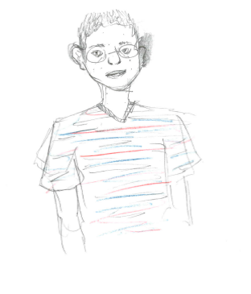
Best Treatment Practices for Gender Dysphoric/Gender Variant Adolescents

Slide 47
Standards of Care
Endocrine Treatment of Transsexual Persons:
An Endocrine Society Clinical Practice Guideline

Slide 48
Options for Social Support and Changes in Gender Expression
In-person and/or online:
Peer support resources, groups, or community organizations that provide avenues for social support and advocacy
Support resources for families and friends
Voice and communication therapy
Hair removal through electrolysis, laser treatment, or waxing
Breast binding or padding, genital tucking or penile prostheses, padding of hips or buttocks
Changes in name and gender marker on identity documents

Slide 49
Treatment Options
Changes in gender expression and role
Psychotherapy
Exploring gender identity, role, and expression
Addressing the negative impact of gender dysphoria and stigma on mental health
Enhancing social and peer support
Improving body image
Promoting resilience
Hormone therapy
Puberty Blockers
Cross-sex Hormones to masculinize or feminize the body
Surgery to change primary and/or secondary sex characteristics

Slide 50
Physical Interventions
Fully reversible interventions
Use of GnRH analogues to suppress estrogen or testosterone production and consequently delay the physical changes of puberty
More time to explore gender nonconformity and other developmental issues
May facilitate transition by preventing the development of sex characteristics that are difficult or impossible to reverse if adolescents continue on to pursue sex reassignment
Partially reversible interventions
Hormone therapy to masculinize or feminize the body
Irreversible interventions
Surgical procedures

Slide 51
Current Recommendations from the PES and Endocrine Society

Slide 52
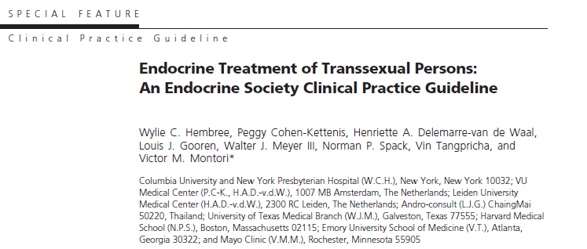
Co-sponsoring Associations:
European Society of Endocrinology (ESE)
European Society of Pediatric Endocrinology (ESPE)
Lawson Wilkins Pediatric Endocrine Society (LWPES)
World Professional Association for Transgender Health (WPATH)
J Clin Endocrinol Metab. September 2009, 94 (9):3132-3154
Notes:
Consensus Process: Committees and members of The Endocrine Society, European Society of
Endocrinology,EuropeanSociety for Paediatric Endocrinology,LawsonWilkins Pediatric Endocrine
Society, and World Professional Association for Transgender Health commented on preliminary
drafts of these guidelines.

Slide 53
Diagnostic Assessment
Has to be made by a mental health provider (MHP)
For children and adolescents, the MHP should also have training in child and adolescent developmental psychopathology
J Clin Endocrinol Metab. September 2009, 94 (9):3132-3154

Slide 54
Treatment
Adolescents who fulfill eligibility and readiness criteria for gender reassignment may undergo treatment to suppress pubertal development with GnRH agonists :
Fulfill DSM or ICD criteria for GID or transsexualism (now GD)
Have experienced puberty to at least Tanner stage 2
Have (early) pubertal changes that have resulted in an increase of their gender dysphoria
Do not suffer from psychiatric comorbidity that interferes with the diagnostic work-up or treatment
Have adequate psychological and social support during treatment, AND
Demonstrate knowledge and understanding of the expected outcomes of GnRH analog treatment, as well as the medical and social risks and benefits of sex reassignment
J Clin Endocrinol Metab. September 2009, 94 (9):3132-3154

Slide 55
Treatment
Pubertal development of the desired opposite sex may be initiated at about the age of 16 years, using a gradually increasing dose schedule of cross-sex steroids
Although parental consent may not be required, obtaining it is preferred because the support of parents should improve the outcome
Defer surgery until the individual is at least 18 years old
Refer hormone-treated adolescents for surgery when:
The real-life experience (RLE) has resulted in a satisfactory social role change
The individual is satisfied with the hormonal effects
The individual desires definitive surgical changes
J Clin Endocrinol Metab. September 2009, 94 (9):3132-3154
Notes:
Rationale:
In many countries, 16-yr-olds are legal adults with regard to medical decision making.
At this age, most adolescents are able to make complex cognitive decisions.
Although parental consent may not be required, obtaining it is preferred because the support of parents should improve the outcome during this
complex phase of the adolescent’s life.

Slide 56
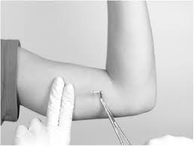
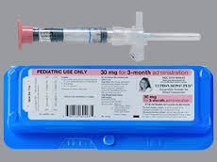
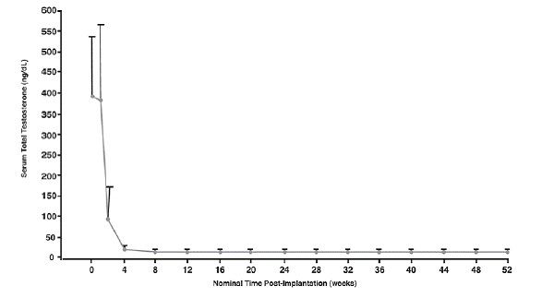
GnRH agonists
Histrelin (Supprelin or Vantas) Implant
Leuprolide (Lupron) IM q 1 or 3 months

Slide 57
Safety of GnRH Analogs
Available for >30 years for children with precocious puberty
Overall considered safe in precocious puberty
GnRHa alone should not affect fertility
Lack of knowledge on the effects of long-term use at an older age (adolescence)
Bone density –decreases, not fully corrected by testosterone or estrogen
Metabolic profile
Brain development

Slide 58
Protocol for Induction of Puberty
BLOCK
GnRH analog treatment until gonadectomy
TACKLE
Mimic puberty: slow increase of estrogen (oral estradiol) or testosterone (IM/SQ)
J Clin Endocrinol Metab. September 2009, 94 (9):3132-3154
Notes:
When puberty is initiated with
a gradually increasing schedule of sex steroid doses, the
initial levels will not be high enough to suppress endogenous
sex steroid secretion (Table 7). The estrogen doses
used may result in reactivation of gonadotropin secretion
and endogenous production of testosterone that can interfere
with the effectiveness of the treatment. GnRH analog
treatment is advised until gonadectomy.

Slide 59
Safety of Cross-Sex Hormones
Adult long-term safety studies suggest that CHT is reasonably safe in transgender individuals⁽¹⁾
Estrogen in MtF
Thromboembolic risk low in young individuals
Testosterone in FtM
Concern of increased CV risk long term
May affect fertility:
Testosterone in transmen: like reversible
Estrogen in transwomen: possibly irreversible, particularly in those that have not completed endogenous puberty
Curr Opin Endocrinol Diabetes Obes. 2013 Dec;20(6):565-92
J Clin Endocrinol Metab, February 2015, 100(2):E270–E275
Notes:
Estrogens-Thromboembolic risk-low in young individuals
Tesosterone-concern of CV risk long term
MTF-concern of low BMD long term, not in FTM

Slide 60
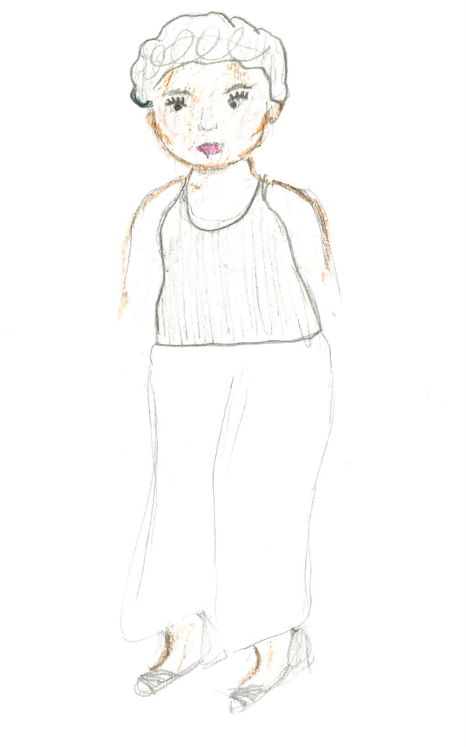
Ethical Analysis of Hormone Treatment
Respect for autonomy
Nonmaleficence
Beneficence

Slide 61
Respect for Autonomy
Legally imposed restriction- below the age of majority
Not all encompassing, consider a minor patient’s assent
Strongest factor supporting progressive hormone treatments
Respect a child’s expressed gender by helping align outward expression of gender
Act during adolescence to achieve optimum results in adulthood
Expand access to and education about treatments available for GD/GV youth

Slide 62
sarahjuliawong.wordpress.com

Slide 63
sarahjuliawong.wordpress.com

Slide 64
Nonmaleficence
Strongest ethical argument against hormone treatment
Puberty blockers
Largely considered free of long term harm in studies of precocious puberty
Buy time
Cross sex hormones
Long-term effects are not well known
Impact on fertility

Slide 65
Beneficence
Cross-sex hormones
Ethical when provider believes the youth is more likely to benefit from treatment rather than regret the consequences (infertility) at a later date
Seriousness of infertility
Weighing consequences
Failure to provide hormone treatment will not cause harm
Common argument against hormone therapies
Supports nonmaleficence
Does not support beneficence if it is assumed that a youth’s desire to have his/her outward gender match experienced gender is valid
Notes:
Obligates physicians to help their patients

Slide 67
GENECIS Readiness Assessment
Current degree of gender dysphoria
Complete history of gender identity development
Psychosexual functioning
Body image concerns
Current wishes regarding medical interventions
Coexisting psychiatric conditions and overall psychological/emotional functioning
Information about the family system, psychiatric history, and support
School and educational information
Social history/peer relationships

Slide 68
Consistent
Persistent
Insistent

Slide 69
Long- Term Psychological Outcomes of Puberty Suppression and Gender Reassignment
55 transgender young adults
22 transwomen
33 transmen
Psychological functioning
Objective well-being
Subjective well-being
Pre Puberty Suppression
Mean Age 13.6
Cross-sex Hormone Therapy
Mean age 16.7
≥ 1 Year After GRA
Mean age 20.7

Slide 70
Long- Term Psychological Outcomes of Puberty Suppression and Gender Reassignment
Generally satisfied with physical appearance
None regretted treatment
Psychological functioning improved steadily over time
Indistinguishable from general population samples
Higher percentage than the general population were pursuing higher education
Both genders benefitted from the clinical approach
Transwomen showed more improvement in body image satisfaction and in psychological functioning
de Vries et al., Young Adult Psychological Outcome After Puberty Suppression and Gender Reassignment. Pediatrics, 2014. 134(4): p. 1-9.

Slide 71
GeMS Data
97 consecutive patients <21 presenting for initial visit between January 1998 and February 2010
44.3% reported significant psychiatric history (n=43)
20.6% reported at least one episode of non suicidal self injury
9.3% reported at least one suicide attempt
Diagnoses | Percentage | Number
Depression GAD Bipolar Disorder PDD Eating Disorder ADHD Other | 58.1% 18.6% 16.3% 9.3% 7.0% 4.7% 6.9% | 25 7 7 4 3 2 3

Slide 72
Boston Community Health Center Data
Retrospective cohort study of electronic health record data
180 transgender patients seen between 2002 and 2011
Ages 12-29
106 FTM
74 MTF
180 cisgender controls (matched on gender identity, age, visit date, and race/ethnicity)
Compares mental health of transgender and cisgender youth in a community-based setting
Disparity in negative mental health outcomes
Burden equally high in FTM and MTF groups

Slide 73
Boston Community Health Center Data
 | Transgender | Cisgender
Depression | 50.6% | 20.6%
Anxiety | 26.7% | 10.0%
Suicidal Ideation | 31.1% | 11.1%
Suicide Attempt | 17.2% | 6.1%
NSSI | 16.7% | 4.4%
Inpatient MH care | 22.8% | 11.1%
Outpatient MH care | 45.6% | 16.1%
Notes:
Reisner (2015) study demographics:
180 transgender youth
106 FTM (transgender male)
74 MTF (transgender female)
61.7% were being treated with cross-sex hormones (n=111)
de Vries 2010
The incidence of 7.8% ASD in gender identity clinic referred children and adolescents is
ten times higher than the prevalence of 0.6–1% of ASD in the general population (Baird et al. 2006; Fombonne 2005).

Slide 74
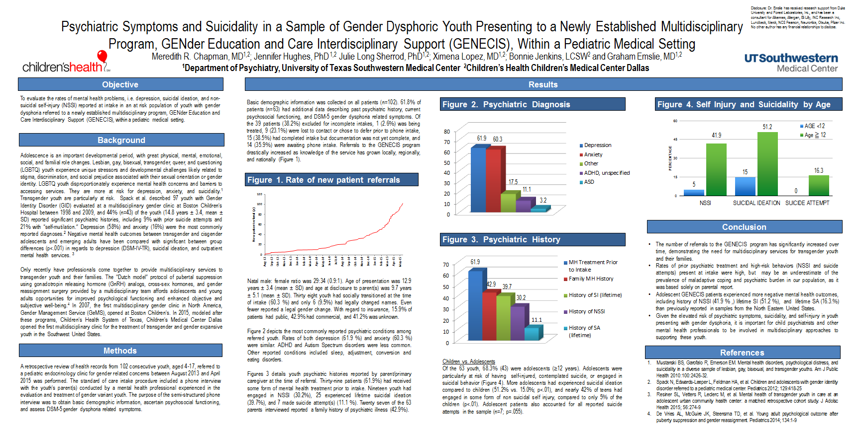

Slide 75
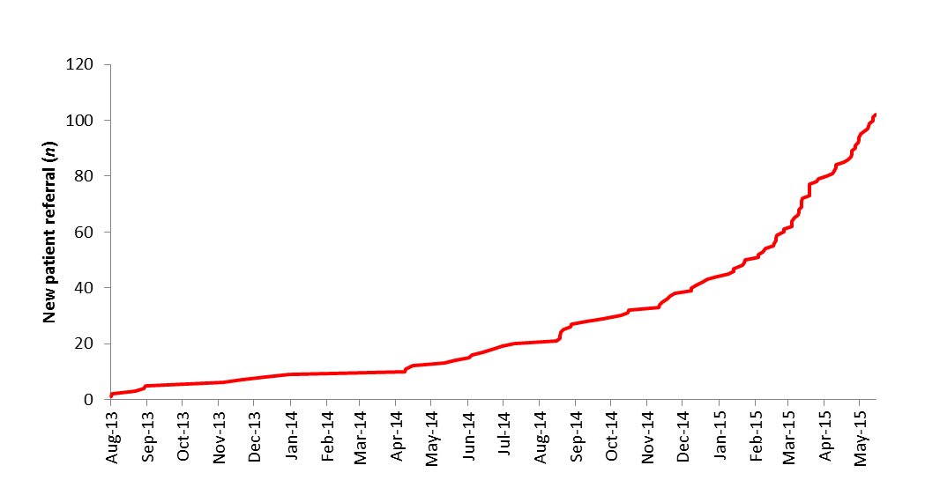
Rate of New Patient Referral

Slide 76
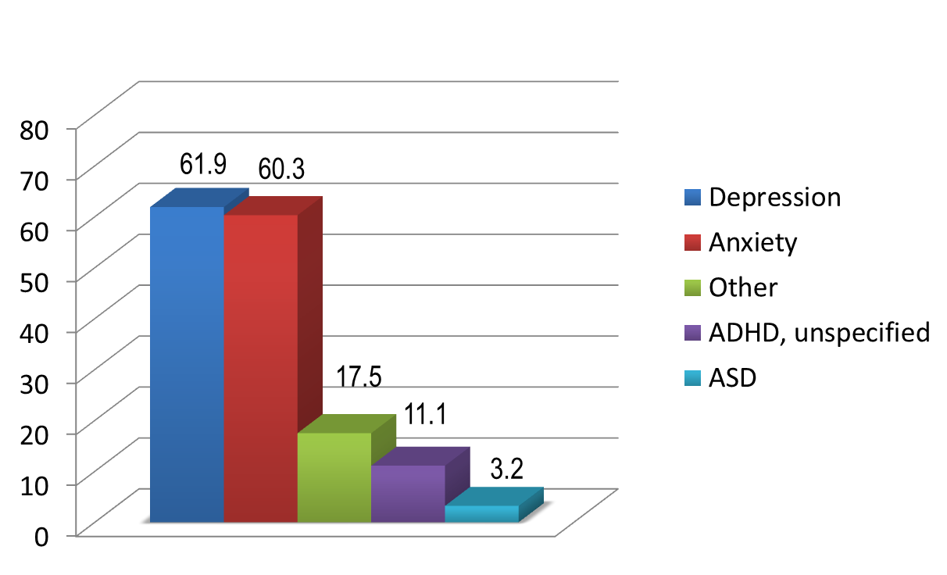
Psychiatric Diagnosis

Slide 77
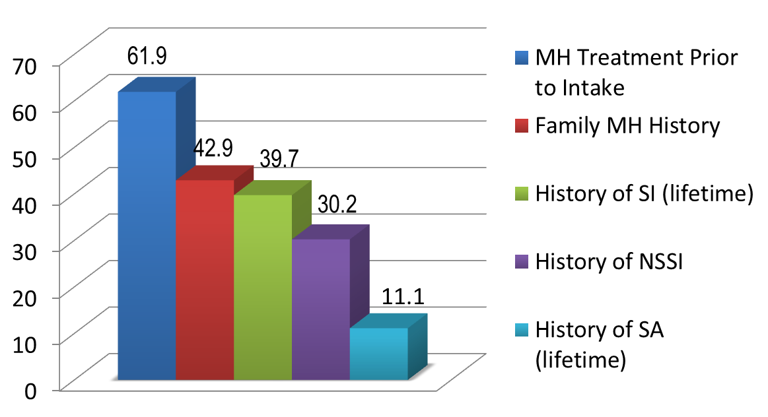
Psychiatric History

Slide 78
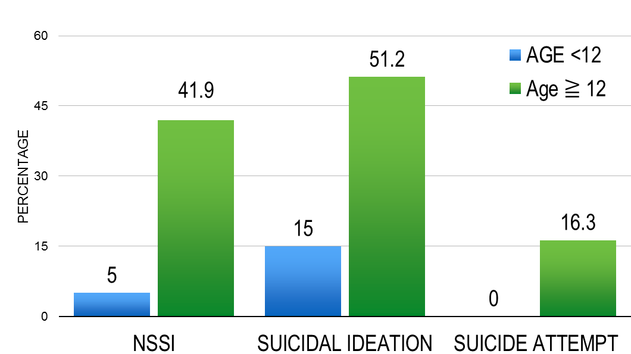
Self-Injury and Suicidality by Age

Slide 79
Resources
Notes:
Individual counseling
Safe spaces at school / collaboration with school counselors
Therapists in the area that provide care specifically for children/adolescents with gender dysphoria
Family counseling
Support groups
Children or adolescents (Feleshia, Amy, GEAR)
Parents
Conferences and online support community (Gender Spectrum – California, Gender Odyssey – Washington, Gender Infinity – Texas)
Gender Camps for children (California, New Hampshire, Washington)
Transgender Education Network of Texas (TENT)
In at recent study conducted by Rady Children’s Hospital in San Diego
42 study participants in their clinic
7 patients received puberty blockers
32 cross-sex hormones
Mental health follow-up data were available for 22 of these patients - indicated that with treatment, depression, anxiety and/or self-cutting in all by two of these patients
The Endocrine Society. (2015, March 8). High need for treatment of transgender youth. ScienceDaily. Retrieved March 22, 2015 from www.sciencedaily.com/releases/2015/03/150308091402.htm

Slide 80
Suggested Readings
Brill, Stephanie and Pepper, Rachel. The Transgender Child: A Handbook for Families and Professionals. San Francisco: Cleis Press, 2008.
Ehrensaft, Diane. Gender Born, Gender Made: Raising Healthy Gender-Nonconforming Children. New York: The Experiment, 2011.
Teich, Nicholas. Transgender 101: A Simple Guide to a Complex Issue. New York: Columbia University Press, 2012.
Gay-Straight Alliance Network, Transgender Law Center, National Center for Lesbian Rights. Beyond the Binary: A Tool Kit for Gender Identity Activism in Schools. San Francisco: Gay-Straight Alliance Network, 2004.
Hubbard, Eleanor A. and Whitley, Cameron T., ed. Trans-Kin: A Guide for Family & Friends of Transgender People. Boulder: Boulder Press, 2012.
Krieger, Irwin. Helping your Transgender Teen: A Guide for Parents. New Haven: Genderwise Press, 2011.

Slide 81
Children’s Books
Carr, Jennifer, Be Who You Are! Illus. Ben Rumback. Bloomington, Indiana: AuthorHouse, 2010.
Herthel, Jessica and Jenning, Jazz. I Am Jazz. Illus. Shelagh McNicholas. New York: Penguin Group, 2014.
Kilodavis, Cheryl. My Princess Boy. Illus. Suzanne DeSimone. New York: Aladdin, 2010.
Kiernan-Johnson, Eileen. Roland Humphrey is Wearing a What? Illus. Katrina Revenaugh. Boulder: Huntley Rahara Press, 2012.
Parr, Todd. It’s Okay to Be Different. New York: Hachette Book Group, 2001.

Slide 82
Suggested Web Resources
GENder Education and Care Interdisciplinary Support (GENECIS) : https://www.childrens.com/specialties-services/specialty-centers-and-programs/endocrinology/programs-and-services/genecis-program
World Professional Association for Transgender Health (WPATH): www.wpath.org
Trans Youth Family Allies (TYFA): www.imatyfa.org
Parents, Families & Friends of Lesbians & Gays (PFLAG): www.community.pflag.org
International Foundation for Gender Education: www.wfge.org
Gender Spectrum Education & Training: www.genderspectrum.org
Gay, Lesbian, & Straight Education Network (GLSEN): www.glsen.org
Gay and Lesbian Medical Association (GLMA): www.glma.org

Slide 83
Suggested Web Resources
Family Acceptance Project: for GLBT, diverse families at risk for suicide, DV, mental health issues, homelessness: http://familyproject.sfsu.edu/
The Trevor Project: suicide prevention for sexual and gender minority youth: www.thetrevorproject.org
Amplify Your Voice: News, message boards, list-serves for GLBT youth by state: www.amplifyyourvoice.org/youthresources
Gay and Lesbian National Hotline: toll-free, anonymous peer counseling, information and referrals with huge database: www.glnh, (888.THE.GLNH)
Trans Youth Equality Foundation (TYEF): support, resources and networking services, based in Portland, ME, www.transyouthequality.org

Slide 84
Suggested Web Resources
GeMS (Gender Management Service, Boston Children’s Hospital): medical and mental health care, consultation and referral for gender non-conforming youth. (617.355.7476) www.childrenshospital.org/clinicalservices/Sites2280/mainpageS2289PO.html,
Children’s National Hospital Gender and Sexuality Psychosocial Programs, under the direction of Dr. Edgardo Menvielle, Washington DC: www.childrensnational.org (search: Gender) email:gender@childrensnational.org
Lambda Legal, national organization committed to achieving full recognition of the civil rights of lesbians, gay men, bisexuals, transgender people and those with HIV through impact litigation, education and public policy work: http://www.lambdalegal.org/

Slide 85
Suggested Web Resources
Gender Odyssey, an international conference, located in Seattle, WA, focused on the needs and interests of transgender and gender-nonconforming people: http://www.genderodyssey.org/
Gender Spectrum, education, training and support to help create a gender sensitive and inclusive environment for children of all ages: https://www.genderspectrum.org/

Slide 86
Texas Resources
Transgender Education Network of Texas (TENT): dedicated to furthering the cause of Gender Diverse people in Texas, www.transtexas.org
Trans Pride Initiative: working to provide assistance and support for transgender, transsexual, and gender nonconforming persons in areas of healthcare, housing, employment, education, and public accommodations, http://tpride.org/
Resource Center Dallas: LGBT service organization offering support, resources, advocacy and education, http://www.rcdallas.org/

Slide 87
Question & Answer

Slide 88
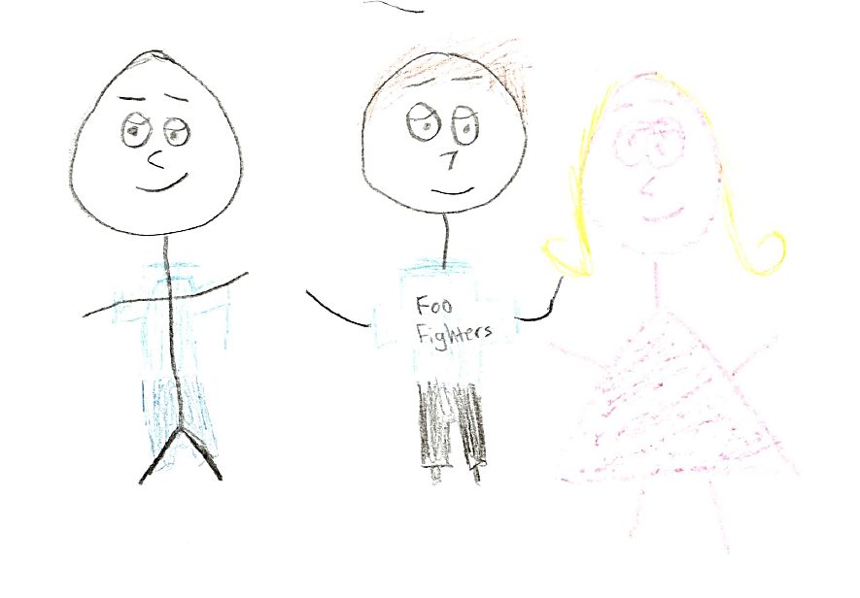

Slide 89
References
Abel BS. (2014). Hormone Treatment of Children and Adolescents with Gender Dysphoria: An Ethical Analysis. LGBT Bioethics: Visibility, Disparities, and Dialogue Hastings Center Report 44 (no.5)
American Academy of Child and Adolescent Psychiatry (AACAP) Committee on Quality Issues (CQI). (2012). Practice Parameter on Gay, Lesbian or Bisexual Sexual Orientation, Gender-Nonconformity, and Gender Discordance in Children and Adolescents. Journal of the American Academy of Child and Adolescent Psychiatry, Vol. 51 (9) 957-974.
Adelson, SL, and Schuster, MA (in press). “Gay, Lesbian & Bisexual Adolescents” In: RM Kliegman, BF Stanton, J St. Geme & N Schor, (Eds.), Nelson Textbook of Pediatrics, 20th Edition (Philadelphia: Elsevier)

Slide 90
References
American Psychiatric Association (2013). Diagnostic and statistical manual of mental disorders, Ed 5 (Washington, DC, American Psychiatric Publishing)
Bockting, Walter O (in press). “Sexual Identity Development.” In: RM Kliegman, BF Stanton, J St. Geme & N Schor, (Eds.), Nelson Textbook of Pediatrics, 20th Edition (Philadelphia: Elsevier)
Cole, Sandra S, Denny, Dallas, Eyler, Evan A., & Samons, Sandra L (2000). Issues of transgender. In: Lenore T. Szuchman & Frank Muscarella (Eds.), Psychological perspectives of human sexuality (Hoboken, NJ: John Wiley & Sons), xiv, pp. 149-195

Slide 91
References
de Vries, AL, Cohen-Kettenis, PT (2012). Clinical management of gender dysphoria in children and adolescents: the Dutch approach. J. Homosex. 59, 301–320.
de Vries AL, Steensma TD, Doreleijers TA, Cohen-Kettenis PT (2010). Puberty suppression in adolescents with gender identity disorder: a prospective follow-up study. J Sex Med 8:2276-2283.
de Vries AL, Kreukels BP, Steensma TD, Doreleijers TA, Cohen-Kettenis PT (2011). Comparing adult and adolescent transsexuals: an MMPI-2 and MMPI-A study. Psychiatry Res 186:414-418.
Drescher J, Pula J. (2014). Ethical Issues Raised by the Treatment of Gender-Variant Prepubescent Children. LGBT Bioethics: Visibility, Disparities, and Dialogue Hastings Center Report 44 (no.5)
Drummond, KD, Bradley, SJ, Peterson-Badali, M, & Zucker, KJ (2008). A follow-up study of girls with gender identity disorder. Developmental Psychology, 44, 34–45.

Slide 92
References
Ehrbar, Randall D., et al. (2008). "Clinician judgment in the diagnosis of gender identity disorder in children." Journal of Sex & Marital Therapy 34.5: 385-412.
Green R (1987). The "Sissy-Boy Syndrome" and the Development of Homosexuality. (New Haven: Yale University Press).
Harrison, Jack, Jaime Grant, and Jody L. Herman (2012). "A gender not listed here: Genderqueers, gender rebels, and otherwise in the National Transgender Discrimination Survey."
Hembree WC (2011). Guidelines for pubertal suspension and gender reassignment for transgender adolescents. Child Adolesc Psy- chiatr Clin N Am 20:725-732.
Hembree WC, Cohen-Kettenis P, et al. (2009). Endocrine Treatment of Transsexual Persons: an Endocrine Society Clinical Practice Guideline. Clin Endocrinol Metab 94:3132-3154.

Slide 93
References
Institute of Medicine (US), Committee on Lesbian, Gay, Bisexual, and Transgender Health Issues and Research Gaps and Opportunities (2011). The Health of Lesbian, Gay, Bisexual, and Transgender People: Building a Foundation for Better Understanding. Washington (DC): National Academies Press (US).
Johnson LL, Bradley SJ, Birkenfeld-Adams AS, et al. (2004). A parent- report gender identity questionnaire for children. Arch Sex Behav 33:105-116.
Kuper, Laura E., Robin Nussbaum, and Brian Mustanski (2012). "Exploring the diversity of gender and sexual orientation identities in an online sample of transgender individuals." Journal of sex research 49.2-3: 244-254.

Slide 94
References
Landén, M, Wålinder, J, & Lundström, B (1998). Clinical characteristics of a total cohort of female and male applicants for sex reassignment: a descriptive study. Acta Psychiatr Scand 97(3): 189-94.
Lawrence, AA (2010). Societal individualism predicts prevalence of nonhomosexual orientation in male-to-female transexualism. Arch Sex Behavior 39 (2): 573-83.
Leibowitz, S, Adelson, S, and Telingator, C (in press). “Gender Nonconformity and Gender Discordance in Childhood and Adolescence: Developmental Considerations and the Clinical Approach.” In: HJ Makadon, KH Mayer, J Potter, and H Goldhammer (Eds.), The Fenway Guide to Lesbian, Gay, Bisexual and Transgender Health, 2nd Edition (American College of Physicians).

Slide 95
References
Marshall, B. D. L., K. Shannon, T. Kerr, R. Zhang, and E. Wood (2010). Survival sex work and increased HIV risk among sexual minority street-involved youth. Journal of Acquired Immune Deficiency Syndromes: JAIDS 53(5):661–664.
Menvielle EJ, Tuerk C (2002). A support group for parents of gender- nonconforming boys. J Am Acad Child Adolesc Psychiatry. 41:1010-1013.
Meyer, I. H. (2003). Prejudice as stress: Conceptual and measurement problems. American Journal of Public Health, 93(2), 262–265.
Meyer-Bahlburg, Heino FL, et al. (2004). "Prenatal androgenization affects gender-related behavior but not gender identity in 5–12-year-old girls with congenital adrenal hyperplasia." Archives of Sexual Behavior 33.2: 97-104.

Slide 96
References
Meyer-Bahlburg HFL (2002). Gender identity disorder in young boys: a parent- and peer-based treatment protocol. Clin Child Psychol Psychiatry 7:360-376.
Nuttbrock, Larry, et al. (2010). "Psychiatric impact of gender-related abuse across the life course of male-to-female transgender persons." Journal of Sex Research 47.1: 12-23.
Roberts AL, Rosario M, Slopen N, Calzo JP, Austin SB (2012). Childhood gender nonconformity, bullying victimization, and depressive symptoms across adolescence and early adulthood: an 11-year longitudinal study. J Am Acad Child Adolesc Psychiatry. Feb;52(2):143-52

Slide 97
References
Singh D, Deogracias JJ, Johnson LL, et al. (2010). The Gender Identity/ Gender Dysphoria Questionnaire for Adolescents and Adults: further validity evidence. J Sex Res 47:49-58.
Steensma TD, Biemond R, de Boer F, Cohen-Kettenis PT (2011). Desisting and persisting gender dysphoria after childhood: a qualitative follow-up study. Clin Child Psychol Psychiatry. 16(4):499-516.
Steensma, Thomas D., et al. (2013). Factors associated with desistence and persistence of childhood gender dysphoria: A quantitative follow-up study. Journal of the American Academy of Child & Adolescent Psychiatry 52.6: 582-590.
Steensma TD, Cohen-Kettenis PT (2011). Gender transitioning before puberty. Arch Sex Behav. 40:649-650

Slide 98
References
Vrouenraets LJJJ, Fredriks AM, Hannema SE, Cohen-Kettenis PT, and de Vries MC. (2015). Early Medical Treatment of Children and Adolescents With Gender Dysphoria: An Empirical Ethical Study. J Adolesc Health xxx:1-7.
Wallien MS, Quilty LC, Steensma TD, et al. (2009). Cross-national replication of the Gender Identity Interview for Children. J Person Assess. 91:545-552.
Wallien, MSC & Cohen-Kettenis, PT (2008). Psychosexual outcome of gender dysphoric children. J Am Acad Child Adolesc Psychiatry, 47, 1413–1423.
Wilson, E. C., R. Garofalo, R. D. Harris, A. Herrick, M. Martinez, J. Martinez, and M. Belzer (2009). Transgender female youth and sex work: HIV risk and a comparison of life factors related to engagement in sex work. AIDS & Behavior 13(5):902–913.

Slide 99
References
Wood, H, Sasaki, S, Bradley, SJ, et al. (2013). Patterns of referral to a gender identity service for children and adolescents (1976–2011): age, sex ratio, and sexual orientation. J. Sex Marital Ther. 39, 1–6
World Professional Association for Transgender Health. (2012). Standards of Care for the Health of Transsexual, Transgender, and Gender-Nonconforming People (Version 7). Minneapolis, MN
Zucker KJ, Bradley SJ (1995). Gender Identity Disorder and Psychosexual Problems in Children and Adolescents. New York: Guilford.
Notes:
World Professional Association for Transgender Health. (2012). Standards of Care for the Health of Transsexual, Transgender, and Gender-Nonconforming People (Version 7). Minneapolis, MN

